Slide 1

SPEEDFOX, Intelligent location-Based Speed Control Solution
GISSA Meeting
Disruptive/Emerging GIS Technology/GIS Applications
9 October 2020
Etienne Louw
etienne@enlspatial.co.za

Slide 2

Advanced Driver-Assistance System (ADAS), providing predictable, location-aware speed control that securely and safely assists your drivers in real-time.

Slide 3
Global Trends ADAS Data
Vehicle safety ratings by EURO NCAP
One criteria is Speed Assist: informs the driver of speed limits based on maps or cameras
EUROPE
AUSTRALIA
USA
Europe legislation - 2019
Adopted legislation for Intelligent Speed Assistance
All new vehicles in 2022, all vehicles mandatory by 2024
Australia legislation
ANCAP – Speed Assistance Systems part of safety rating (similar to EURO NCAP)
Expected to follow EU legislation rapidly
NSW implemented state-wide basic ISA testing in 2014
USA legislation
National Highway Traffic Safety Administration acknowledges dangers of speeding
Focus on infrastructure and education, law expected to be forth-coming

Slide 4








Key Features
Key
Features
Real-time, ADAS speed control
Trip data logging for analysis
Off-line road maps
Audible overtake/ accelerate function
Quarterly roadmap updates via secure WIFI
Company specific policy implementation

Slide 5
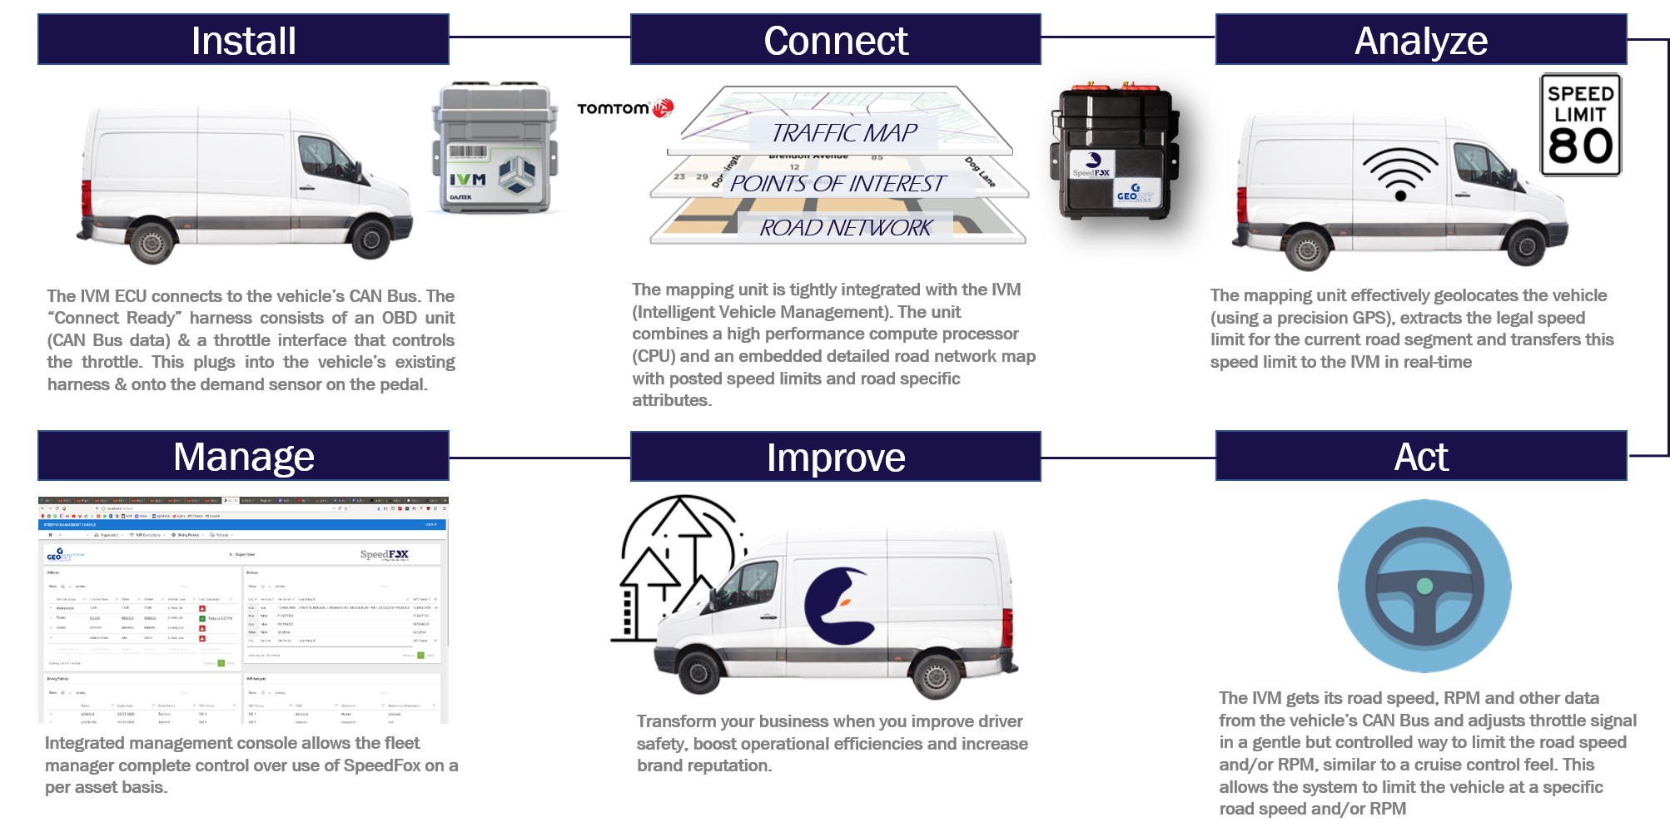

Slide 6

What to
expect

Slide 7

User
Feedback

Slide 8
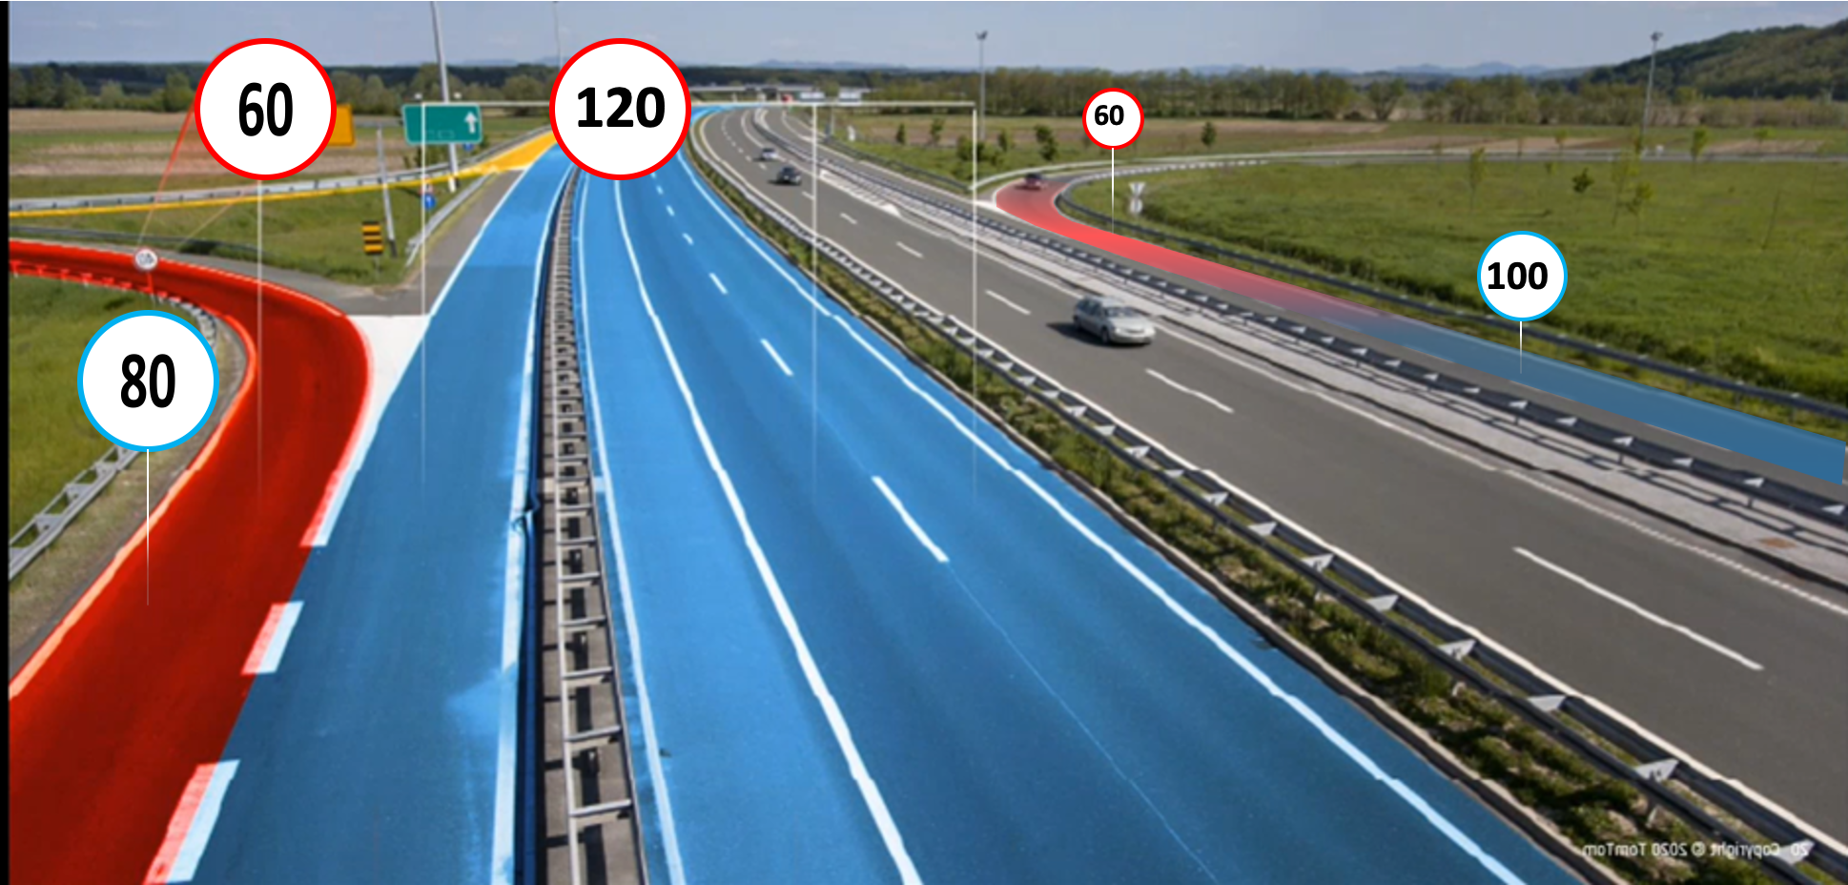
GEOINT Developed Algorithm
Optimized for selecting right road and road speed with intelligence for joining speeds

Slide 9
Q&A
GISSA Meeting
Disruptive/Emerging GIS Technology/GIS Applications
9 October 2020
Etienne Louw
etienne@enlspatial.co.za

